Slide 1
Flow Control

Slide 2
Flow Control
Important Design issue for the cases when the sender is running on a fast powerful computer and receiver is running on a slow low-end machine.
Two approaches:
Feedback-based flow control
Rate-based flow control

Slide 3
Feedback-based Flow Control
Receiver sends back information to the sender giving it permission to send more data, or
Telling sender how receiver is doing.

Slide 4
Rate-based Flow Control
Built in mechanism that limits the rate at which sender may transmit data, without the need for feedback from the receiver.

Slide 5
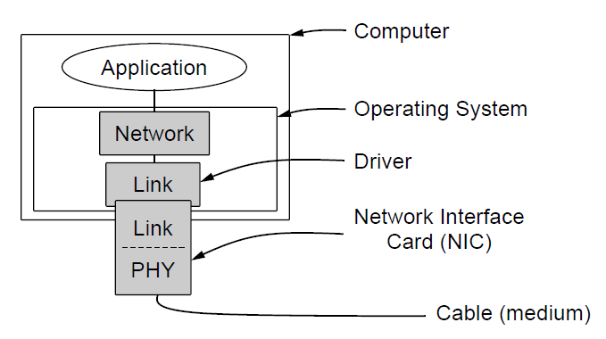
Elementary Data Link Protocols
Implementation of the physical, data link, and network layers.

